Slide 1


Importance of Energy Access
Access to affordable, reliable, sustainable, and modern energy is crucial for the development and well-being of communities worldwide. It's a fundamental need that underpins economic growth, enhances living standards, and enables access to critical services such as healthcare and education.

Slide 2

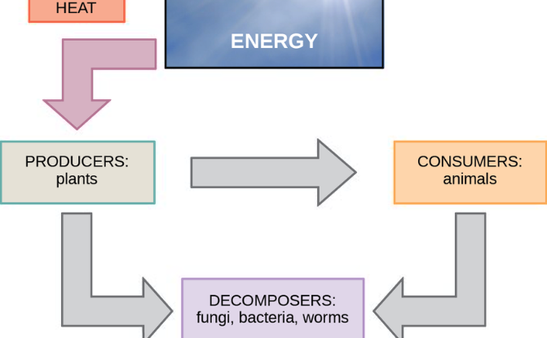
Challenges in Energy Access
High Costs and Inconsistency
Sustainability and Modernization
Many countries face challenges with the affordability and reliability of energy, resulting in inconsistent access and hindering progress.
Lacking access to sustainable and modern energy options poses significant obstacles to development and hinders environmental sustainability.

Slide 3
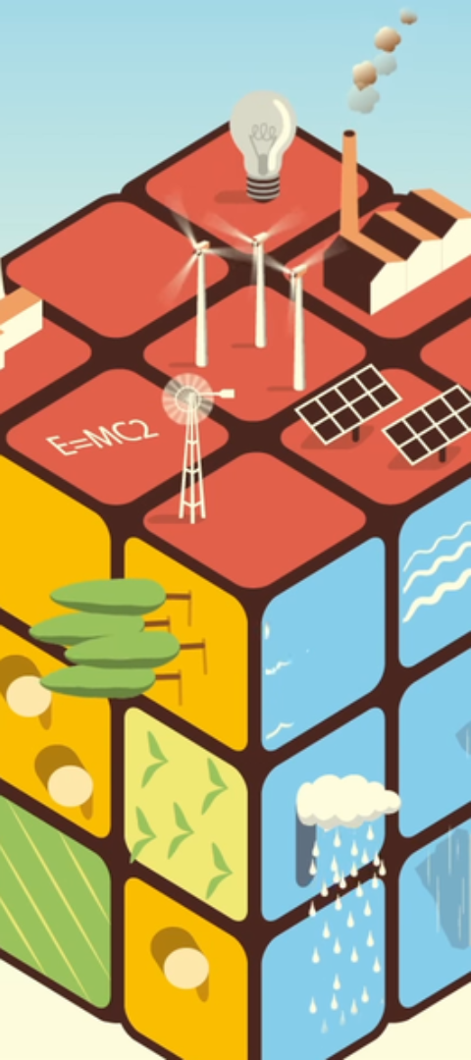
WEBSITE Purpose and Goals
1
Empowerment through Information
The WEBSITE aims to provide vital information and tools to empower communities and individuals to pursue sustainable energy solutions.
2
Promotion of Innovative Practices
It seeks to promote innovation and resourcefulness in addressing energy challenges, driving progress towards sustainable energy adoption.
3
Strategic Capacity Building
The WEBSITE is designed to facilitate capacity building, knowledge-sharing, and collaboration among stakeholders involved in energy access initiatives.
4
Stepped-up efforts in renewable energy
The WEBSITE is designed to facilitate the energy supply to all the localities, after identifying the localities we forward the location info the availability of resources so that the companies are collaborated with us and the government at that location can together figure out what the things that could be done in to bring a change

Slide 4

website Features and Functionalities
Resource Repository
Collaboration Platform
The website includes a comprehensive repository of resources, guides, and best practices for energy access projects.
It provides a platform for stakeholders to collaborate, share insights, and engage in discussions on energy access strategies.
Project Management Tools
GOVERNMENT SUPPORT
Integrated project management tools for planning, executing, and monitoring sustainable energy initiatives.
This should be possible only if the government at that place supports the organization, with minimum funding and resources

Slide 5

Benefits of Using the App
1
Knowledge Enhancement
2
Networking Opportunities
The app facilitates the enhancement of knowledge and skills in sustainable energy practices.
Users gain access to a wide network of experts, organizations, and resources, fostering valuable connections and collaborations.
3
Impact Assessment
4
JOBS
It enables the assessment and measurement of the impact of energy access projects, and a way to assess overall development.
this ensures with the working opportunities to the people who are in the reverent areas and this field

Slide 6




OVER VIEW OF WORKING
Community Transformation
Technological Innovations
Policy and Advocacy Impact
Examples of successful energy access projects leading to improved community well-being and economic development.
Showcasing innovative technologies and applications driving sustainable energy adoption and progress.
Insights into the impact of policy frameworks and advocacy efforts in promoting energy access and sustainability.

Slide 7
Partnerships and Collaborations
Government Partnerships
Industry Engagement
NGO Alliances
Engagement with NGOs and civil society organizations to leverage their grassroots networks for community engagement and project implementation.
Collaborations with local governments and authorities to drive policy initiatives and regulatory support for energy access programs.
Partnerships with industry leaders for knowledge exchange, technology transfer, and support for sustainable energy projects.

Slide 8
Call to Action: Contribution
746 million
Community Projects Supported
Over 746M community-based energy access project, join hands together to support over all development worldwide and sprinkle a bright twinkling smile on millions of people face with electricity.

Slide 9
OVERVIEW OF CODE
Creating a full website involves a detailed development process AND COMPLETE SUPPORT FROM ORGANIZATIONS AND GOVERNMENTS . However, I can provide you with a simplified HTML template that you can use as a starting point. This template includes sections for promoting sustainable energy, identifying areas in need, and inviting sponsors and non-profit organizations. The code is attached below in another file

